Slide 1
OBJECT ORIENTED PRINCIPLES
Favor Composition Over Inheritence
Ethem Basım

Slide 2
Composition
Method of reuse in which new functionality is obtain by creating an object composed of other objects
The new functionality is obtained by delegating functionlaty to one of the objects being composed
Sometimes called aggregation or containment,although some authors give special meaning to these terms
For example:
  Aggregation – when one object owns or is responsible for another object and both objects have identical lifetimes
  Aggregation – When one object has a collection of objects that can exist on their own
  Containment – special kind of composition in which the contained object is hidden from other objects and access to the contained objects is only via the container object

Slide 3
Composition
Composition can be by reference or by value
C++ allows composition by value or by reference
But in Java all we have are object references

Slide 4
Advantages/Disadvantages of Composition
Advantages
  Contained objects are accessed by the containing class solely through their interfaces
  "Black-box" reuse, since internal details of contained objects are not visible
  Good encapsulation
  Fewer implementation dependencies
  Each class is focused on just one task
  The composition can be defined dynamically at run-time through objects acquiring references to other objects of the same type
Disadvantages
  Resulting systems tend to have more objects
  Interfaces must be carefully defined in order to use many different objects as composition blocks

Slide 5
Inheritence
Method of reuse in which new functionality is obtained by extending the implementation of an existing object
The generalization class (the superclass) explicitly captures the common attributes and methods
The specialization class (the subclass) extends the implementation with additional attributes and methods

Slide 6
Advanteges
Advantages:
  New implementation is easy, since most of it is inherited
  Easy to modify or extend the implementation being reused
Disadvantages:
  Breaks encapsulation, since it exposes a subclass to implementation details of its superclass
  "White-box" reuse, since internal details of superclasses are often visible to subclasses
  Subclasses may have to be changed if the implementation of the superclass changes
  Implementations inherited from superclasses can not be changed at run-time

Slide 7
Inheritence vs Composition Example
This example comes from the book Effective Java by Joshua Bloch
Suppose we want a variant of HashSet that keeps track of the number of attempted insertions. So we subclass HashSet as follows:
public class InstrumentedHashSet extends HashSet {
// The number of attempted element insertions
private int addCount = 0;
public InstrumentedHashSet(Collection c) {super(c);}
public InstrumentedHashSet(int initCap, float loadFactor) {
super(initCap, loadFactor);
}

Slide 8
Inheritance vs Composition Example (Continued)
public boolean add(Object o) {
addCount++;
return super.add(o);
}
public boolean addAll(Collection c) {
addCount += c.size();
return super.addAll(c);
}
public int getAddCount() {
return addCount;
}
}

Slide 9
Inheritance vs Composition Example (Continued)
Looks good, right. Let’s test it!
public static void main(String[] args) {
InstrumentedHashSet s = new InstrumentedHashSet();
s.addAll(Arrays.asList(new String[] {"Snap","Crackle","Pop"})); System.out.println(s.getAddCount());
}
We get a result of 6, not the expected 3. Why?
It’s because the internal implementation of addAll() in the HashSet superclass itself invokes the add() method. So first we add 3 to addCount in InstrumentedHashSet’s addAll(). Then we invoke HashSet’s addAll(). For each element, this addAll() invokes the add() method, which as overridden by InstrumentedHashSet adds one for each element. The result: each element is double counted.

Slide 10
Inheritance vs Composition Example (Continued)
There are several ways to fix this, but note the fragility of our subclass. Implementation details of our superclass affected the operation of our subclass.
The best way to fix this is to use composition. Let’s write an InstrumentedSet class that is composed of a Set object. Our InstrumentedSet class will duplicate the Set interface, but all Set operations will actually be forwarded to the contained Set object.
InstrumentedSet is known as a wrapper class, since it wraps an instance of a Set object
This is an example of delegation through composition!

Slide 11
Inheritance vs Composition Example (Continued)
public class InstrumentedSet implements Set {
private final Set s;
private int addCount = 0;
public InstrumentedSet(Set s) { this.s = s; }
public boolean add(Object o) {
addCount++;
return s.add(o);
}
public boolen addAll(Collection c){
addCount += c.size();
return s.addAll(c);
}
public int getAddCount() { return addCount; }

Slide 12
Inheritance vs Composition Example (Continued)
// Forwarding methods (the rest of the Set interface methods)
public void clear( ) { s.clear( ); }
public boolean contains(Object o) { return s.contains(o); }
public boolen isEmpty( ) { return s.isEmpty( ); }
public int size( ) { return s.size( ); }
public Iterator iterator( ) { return s.iterator( ); }
public boolen remove(Object o) { return s.remove(o); }
public boolen containsAll(Collection c) { return s.containsAll(c); }
public boolen removeAll(Collection c) { return s.removeAll(c); }
public boolen retainAll(Collection c) { return s.retainAll(c); }
public Object[] toArray( ) { return s.toArray( ); }
public Object[] toArray(Object[] a) { return s.toArray(a); }
public boolen equals(Object o) { return s.equals(o); }
public int hashCode( ) { return s.hashCode( ); }
public String toString( ) { return s.toStrşng( ); }

Slide 13
Inheritance vs Composition Example (Continued)
Note several things:
  This class is a Set
  It has one constructor whose argument is a Set)
  The contained set object can be an object of any class that implements the Set interface (and not just a HashSet)
  This class is very flexible and can wrap any preexisting Set object
Example:
  List list = new ArrayList( );
  Set s1 = new InstrumentedSet(new TreeSet(list));
  int capacity = 7;
  Float loadFactor = .66f;
  Set s2 = new InstrumentedSet(new HashSet(capacity,loadFactor));

Slide 14
Coad's Rules
Use inheritance only when all of the following criteria are satisfied:
A subclass expresses "is a special kind of" and not "is a role played by a“
An instance of a subclass never needs to become an object of another class
A subclass extends, rather than overrides or nullifies, the responsibilities of its superclass
A subclass does not extend the capabilities of what is merely a utility class
For a class in the actual Problem Domain, the subclass specializes a role, transaction or device

Slide 15
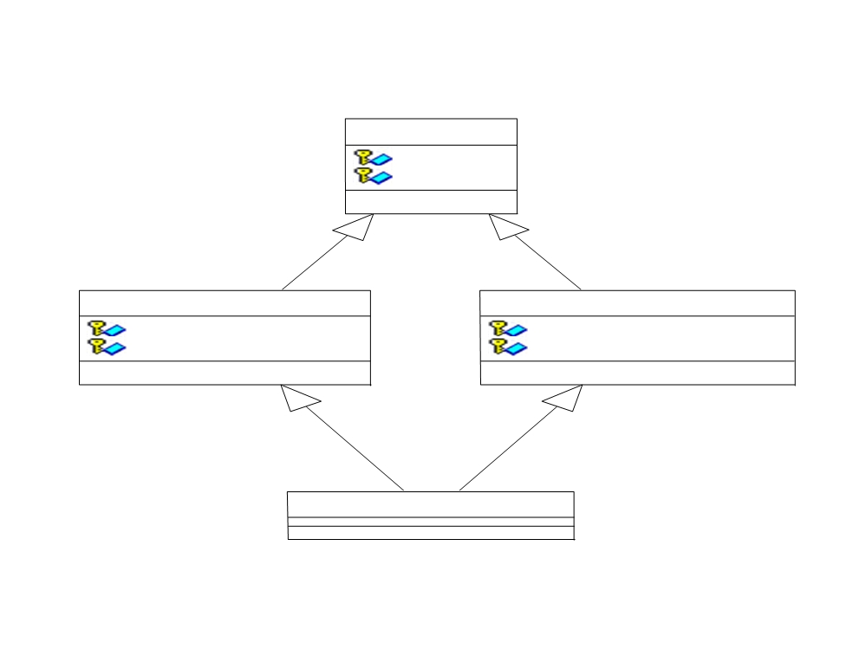
Inheritance/Composition Example 1
Inheritance/Composition Example 1
Person
Name
Address
Passenger
Agent
Frequent Flyer ID
Password
Reservation
Authorization Level
Agent Passenger

Slide 16
Inheritance/Composition Example 1 (Continued)
"Is a special kind of" not "is a role played by a“
  Fail . A passenger is a role a person plays. So is an agent.
Never needs to transmute
  Fail . An instance of a subclass of Person could change from Passenger to Agent to Agent Passenger over time
Extends rather than overrides or nullifies
  Pass
Does not extend a utility class
  Pass
Within the Problem Domain, specializes a role, transaction or device
  Fail . A Person is not a role, transaction or device.
  Inheritence does not fit here

Slide 17
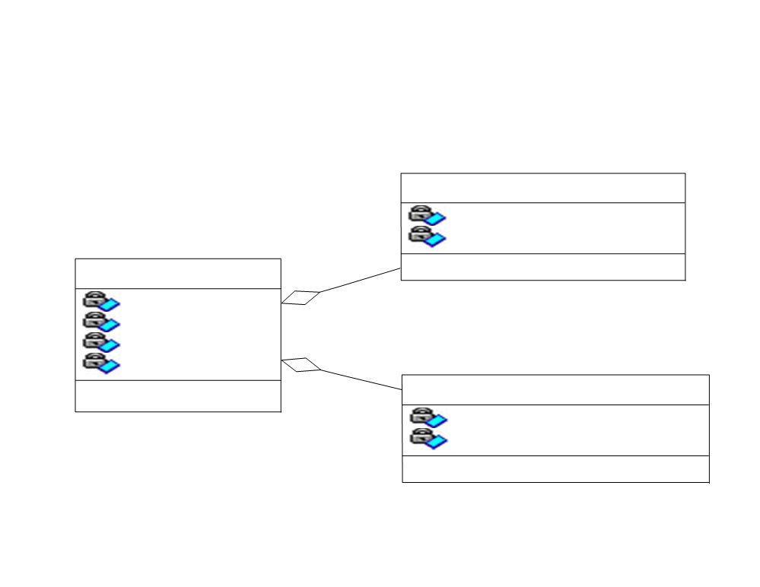
Inheritance/Composition Example 1 (Continued)
Composition to the rescue!
Passenger
Frequent Flyer ID Reservation
Person
Name
Address Passenger Agent
Agent
Password
Authorization Level

Slide 18
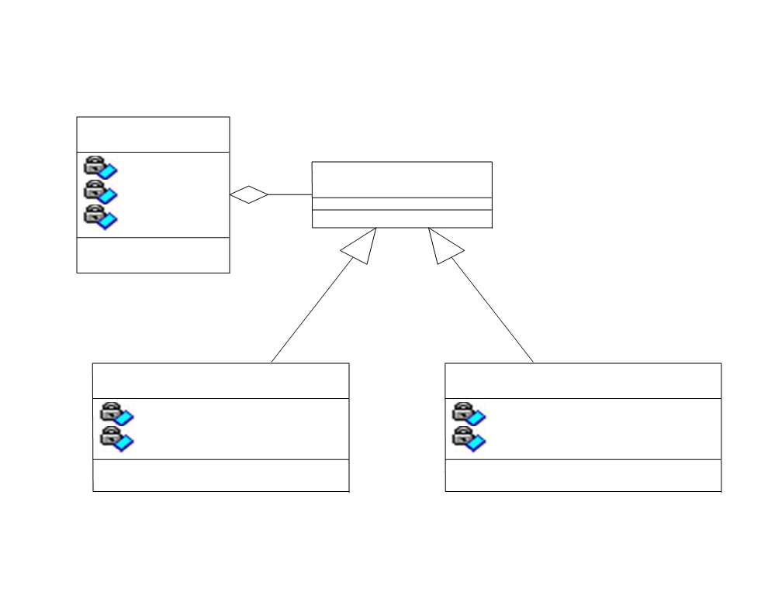
Inheritance/Composition Example 2
Person
Name
PersonRole
Address
Role
Passenger
Agent
Frequent Flyer ID
Password
Reservation
Authorization Level

Slide 19
Inheritance/Composition Example 2 (Continued)
"Is a special kind of" not "is a role played by a“
  Pass . Passenger and agent are special kinds of person roles.
Never needs to transmute
  Pass . A Passenger object stays a Passenger object; the same is true for an Agent object.
Extends rather than overrides or nullifies
  Pass
Does not extend a utility class
  Pass
Within the Problem Domain, specializes a role, transaction or device
  Pass . A PersonRole is a type of role
  Inheritence ok here !

Slide 20
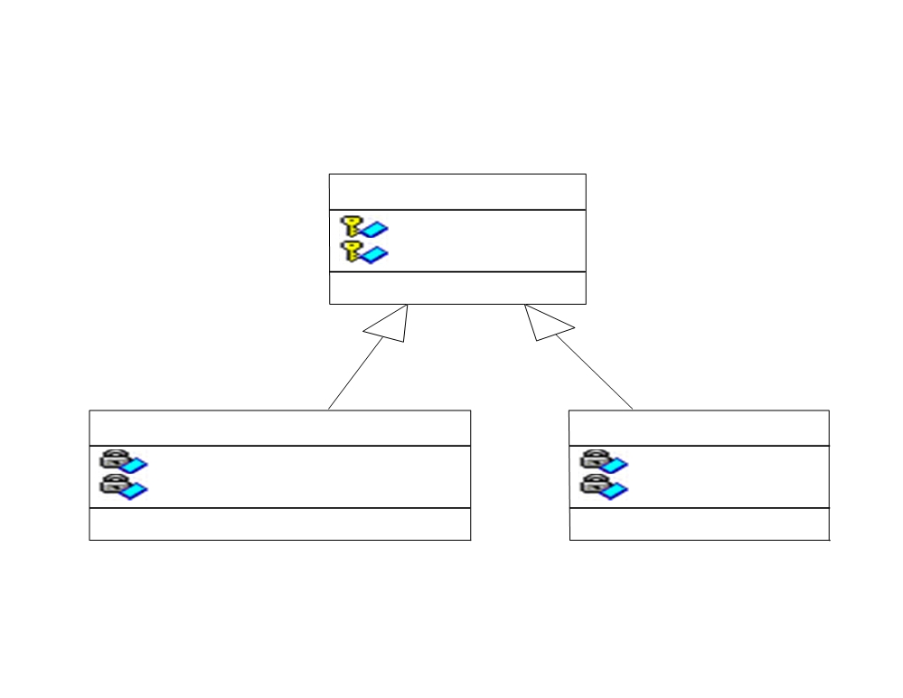
Inheritance/Composition Example 1 (Continued)
Inheritance/Composition Example 3
Composition to the rescue!
Transaction
ID
Passenger
Date
Frequent Flyer ID Reservation
Person
Name
Address Passenger Agent
Reservation
Purchase
DateExpires
ProductSet
Agent
DiscountCategory
Password
Store
Authorization Level

Slide 21
Inheritance/Composition Example 3 (Continued)
"Is a special kind of" not "is a role played by a“
  Pass . Reservation and purchase are a special kind of transaction.
Never needs to transmute
  Pass . A Reservation object stays a Reservation object; the same is true for a Purchase object.
Extends rather than overrides or nullifies
  Pass .
Does not extend a utility class
  Pass .
Within the Problem Domain, specializes a role, transaction or device
  Pass . It's a transaction.
  Inheritence ok here !

Slide 22
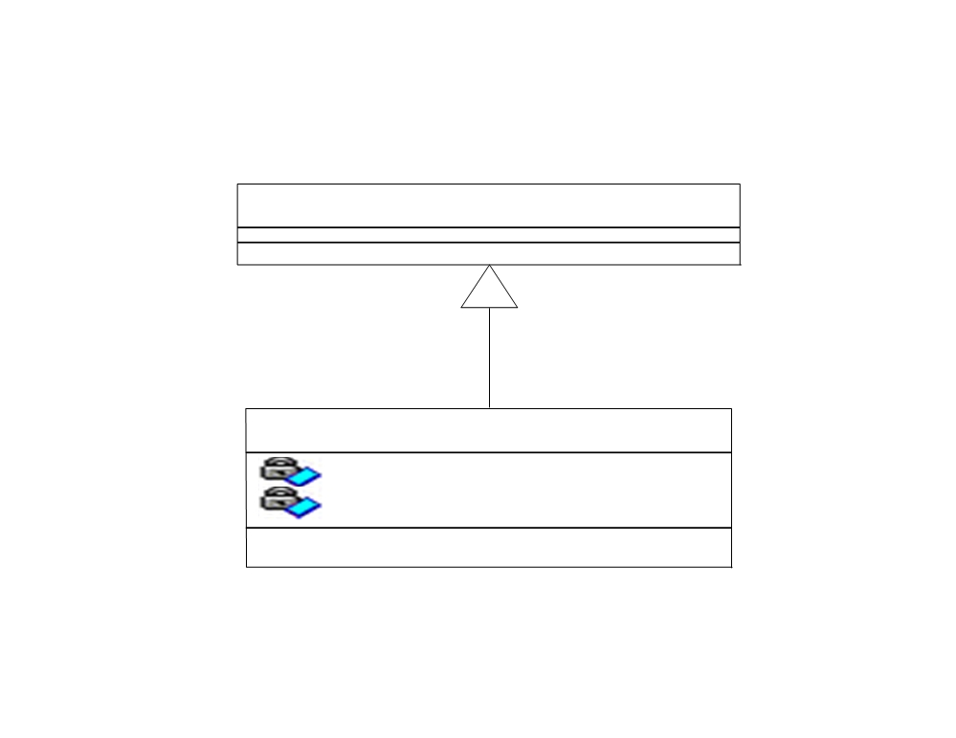
Inheritance/Composition Example 4
java.util.Observable
Reservation
DateExpires
DiscountCategory

Slide 23
Inheritance/Composition Example 4 (Continued)
"Is a special kind of" not "is a role played by a“
  Fail . A reservation is not a special kind of observable
Never needs to transmute
  Pass . A Reservation object stays a Reservation object.
Extends rather than overrides or nullifies
  Pass .
Does not extend a utility class
  Fail . Observable is just a utility class.
Within the Problem Domain, specializes a role, transaction or device
  Not applicable. Observable is a utility class,not a problem domain class
  Inheritence does not fit here

Slide 24
Inheritance/Composition Summary
Both composition and inheritance are important methods of reuse
Inheritance was overused in the early days of OO development
Over time we've learned that designs can be made more reusable and simpler by favoring composition
Of course, the available set of composable classes can be enlarged using inheritance
So composition and inheritance work together

